Slide 1
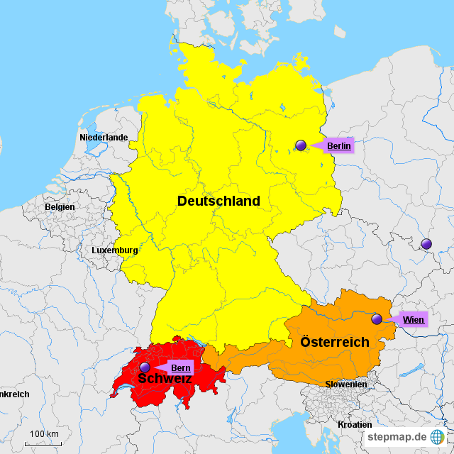
DEUTSCHSPRACHIGE länder EUROPAS

Slide 2
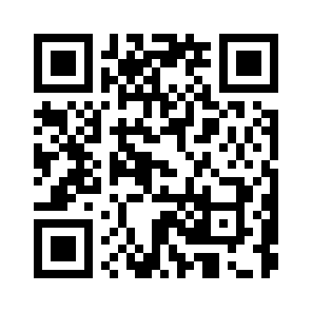
https://wordwall.net/de/resource/1542796/l%C3%A4nder

Slide 3
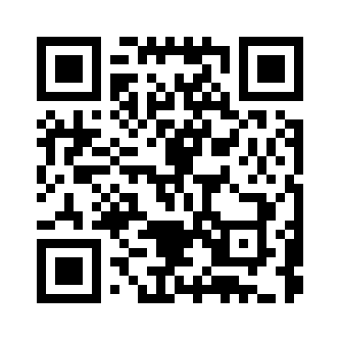
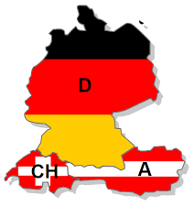
DACH-länder Diagramm
https://wordwall.net/de/resource/30227783/dach-l%C3%A4nder

Slide 4
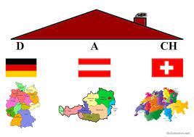
DACH länder Video
https://youtu.be/CmROzY1QHCg

Slide 5
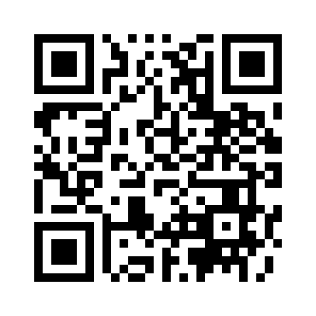
DEUTSCHSPRACHIGE LÄNDER QUIZ
https://wordwall.net/de/resource/35523578

Slide 6
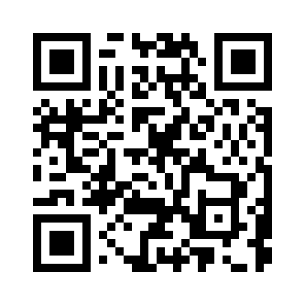
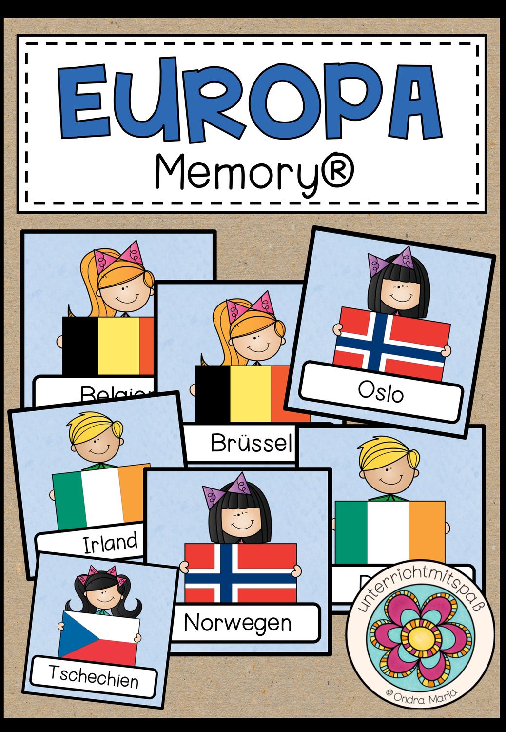
Memory
https://wordwall.net/de/resource/36419133/njema%c4%8dki-jezik/kopija-l%c3%a4nder-in-europa

